Slide 1
WEEK 4 - Tablet Team
Cameron, Sam, Lio, Ray, Diogo and Jose

Slide 2
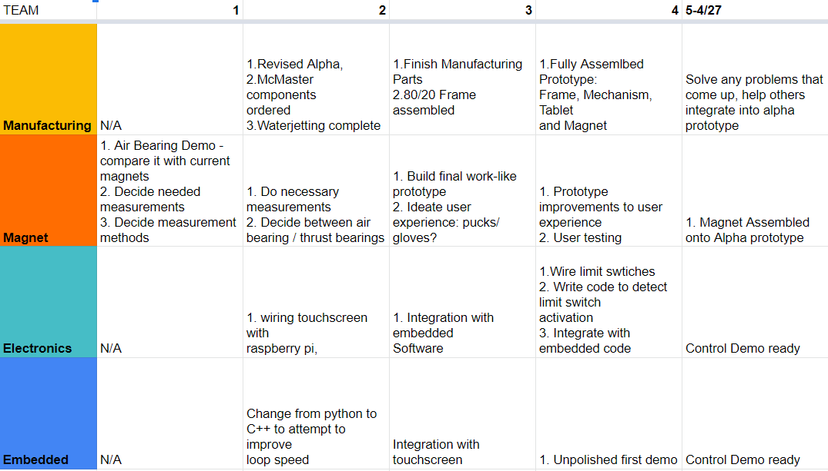
Alpha Timeline

Slide 3
Manufacturing - Cam & Sam
Progress
Almost all parts machined(16/18)
Problems
No M4 taps->most likely change design
Preview
Fully assembled mechanism by Friday

Slide 4
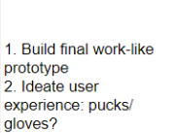
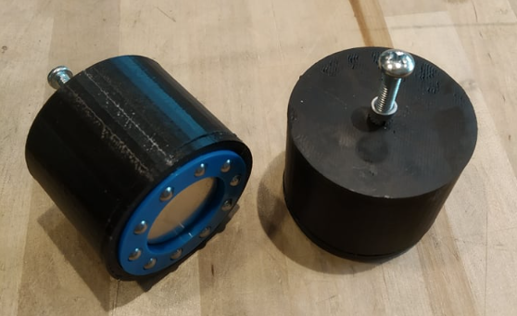
Magnet - Diogo & Jose
Small Neodymium Magnet on top can be combined with a polymagnet on the bottom
Need to combine small magnet with something for the user
Bottom Polymagnet down to 2 choices - Thin or thick 1 inch

Slide 5
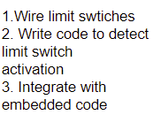
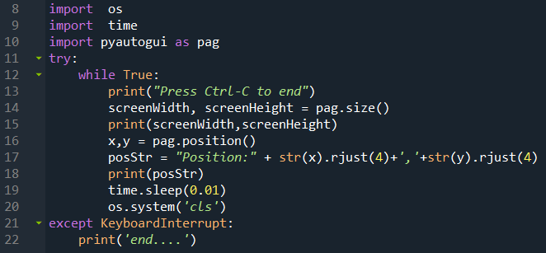
Electronics - Ray
- Progress:
- Touchscreen: Read the position of the touchscreen.
- Problem:
The touch screen from sunFounder just can trace one finger which is like the function of mouse

Slide 6

Electronics - Ray
- Solution:
We need to change to another touch screen which has the ability to trace two fingers at the same time.
10.1"Capacitive Touch Panel with Controller GT9271 10 Point Multi Touch
- Next:
Assemble the electronic components on Alpha and add limit switch on the arm

Slide 7
Embedded - Lio Calibration
ARM zero point calibration:
Switches help define zero point during init
Touch screen arm calibration:
Build a sequence of Multi-points calibration with LSE in order to reduce error
Could Magnet give a stable point during touching?

